Slide 2
OUR GUIDING PHILOSOPHY

Slide 3
PELLET PLANT JDC TEAM TATA STEEL STATIONERY AND OTHER ITEMS DISTRIBUTION AT SANKALP CENTRES

Slide 4
A NOBLE INITIATIVE FOR SANKALP KIDS ON 31.10.2015
Pellet Plant JDC Team, Tata Steel as part of its Volunteerism Week visited Sankalp’s Centre at NIT Jamshedpur premises on 31st October
The session started with a brief interaction of Sankalp Kids with Tata Steel Team
The visiting team inspired kids to not only dream and aspire for a goal but dream fearlessly and overcome all inhibitions.
Stationery Distribution took place for the needy kids.

Slide 5
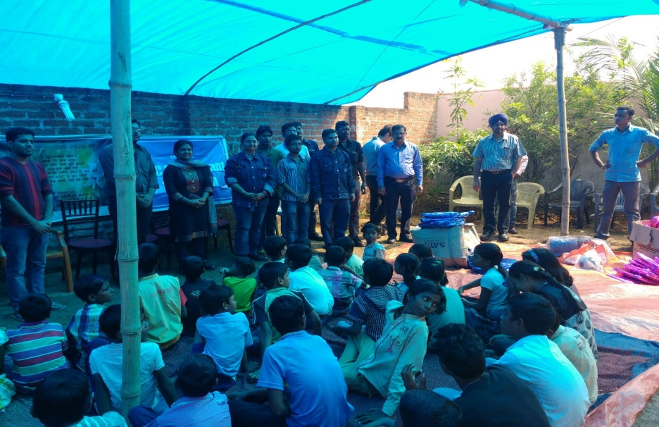
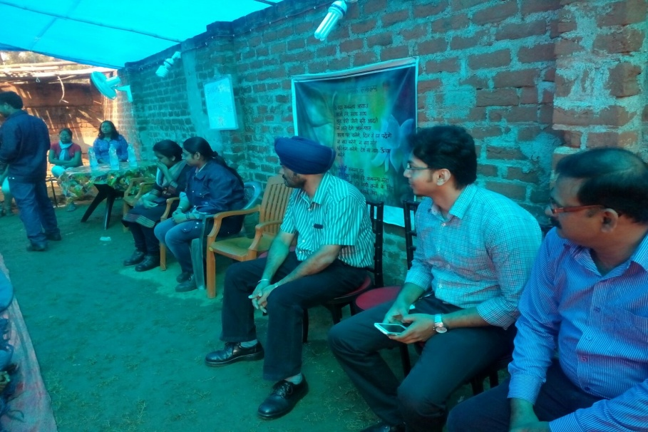
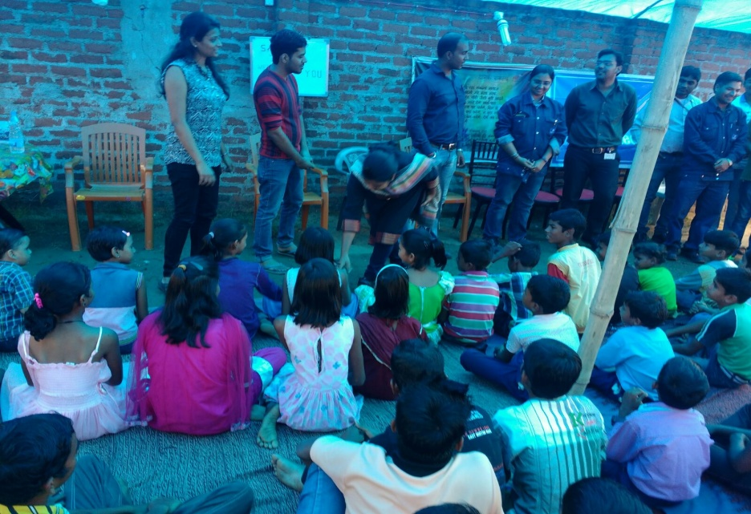
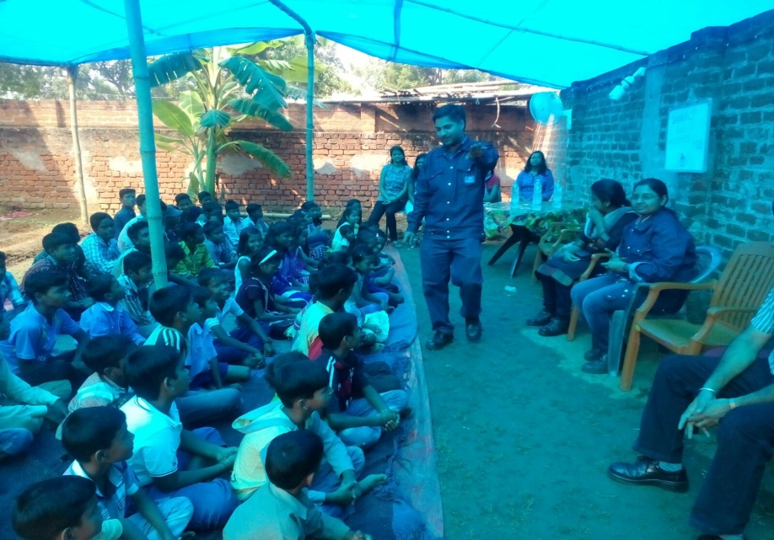
THE TEAM WITH A MISSION

Slide 6
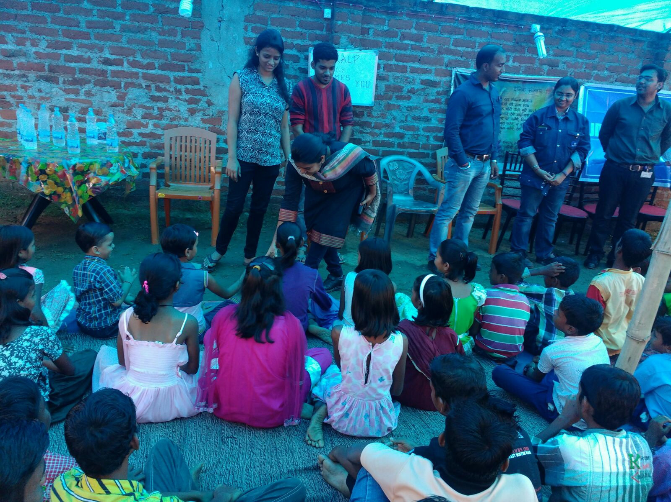
HOLDING LITTLE HANDS

Slide 7
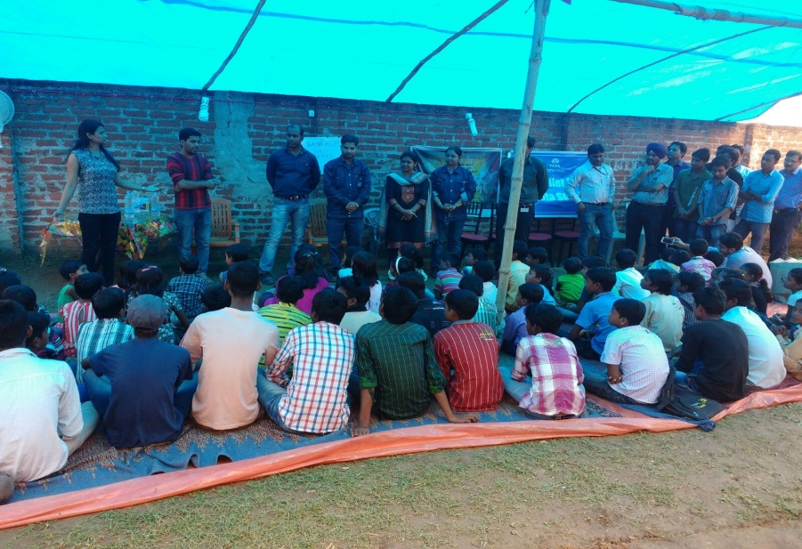
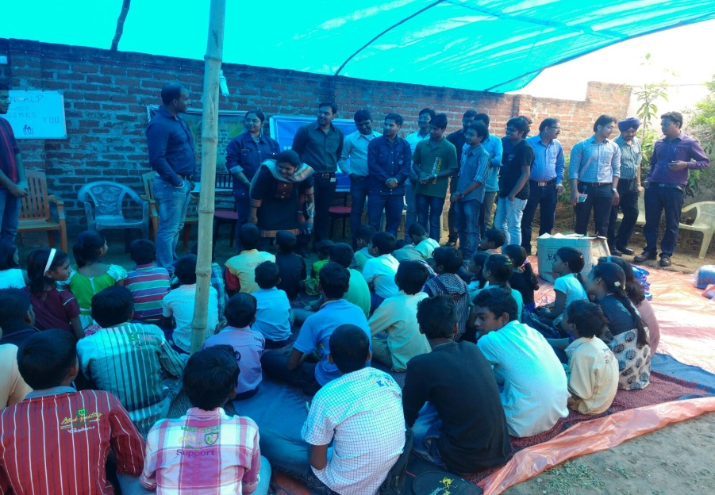
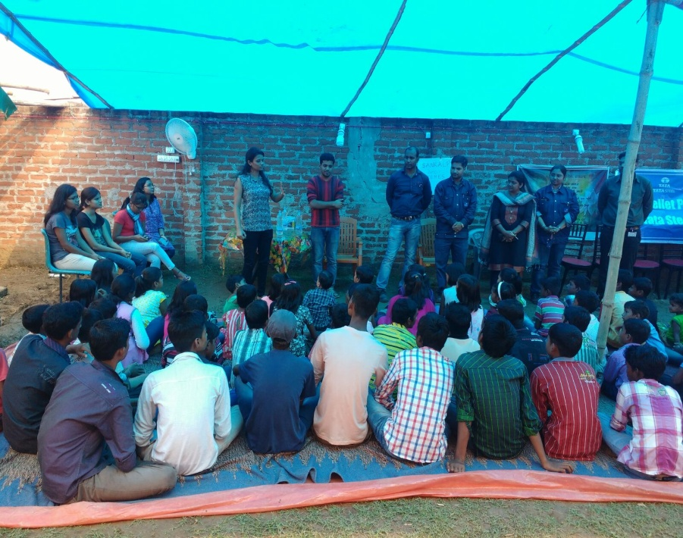
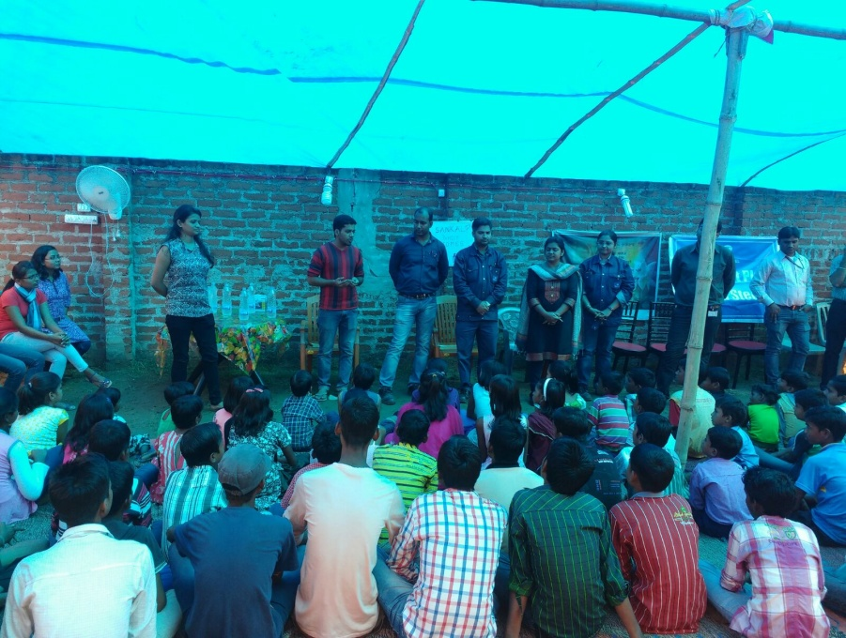
TOGETHER WE CAN

Slide 8
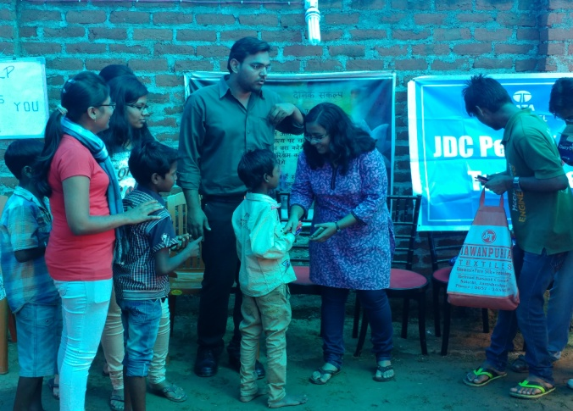
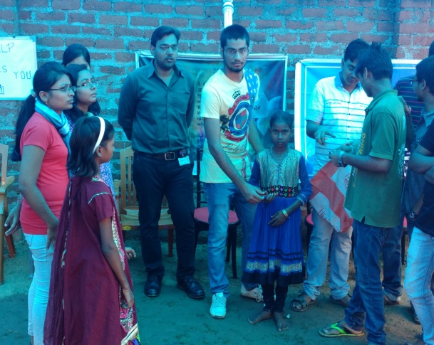
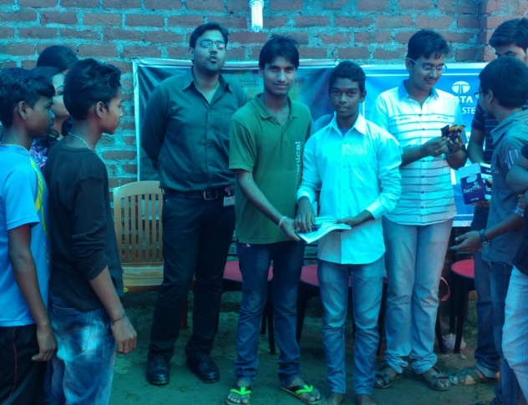
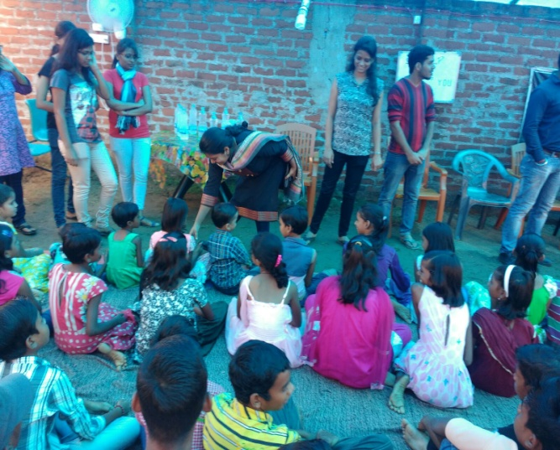
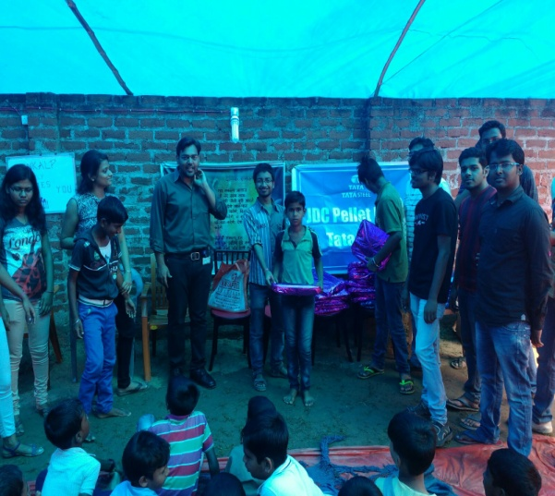
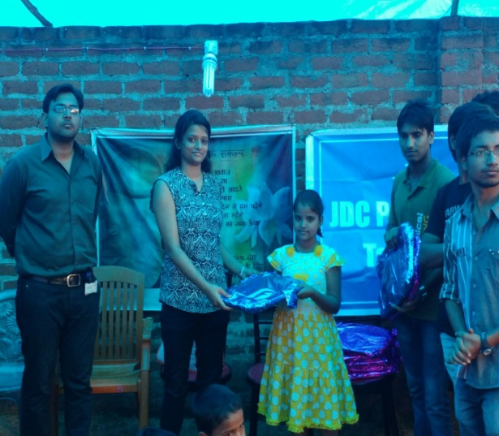
TO SERVE IS BEAUTIFUL, BUT ONLY IF IT IS DONE WITH JOY, WHOLE HEART AND A FREE MIND

Slide 9
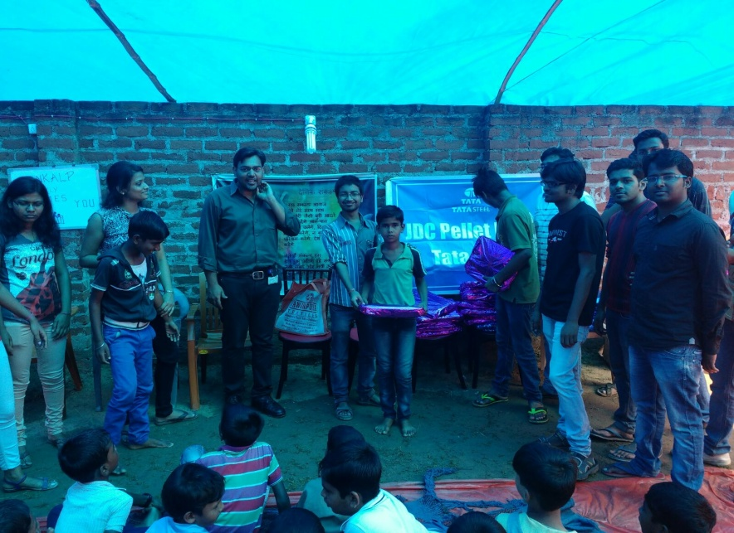
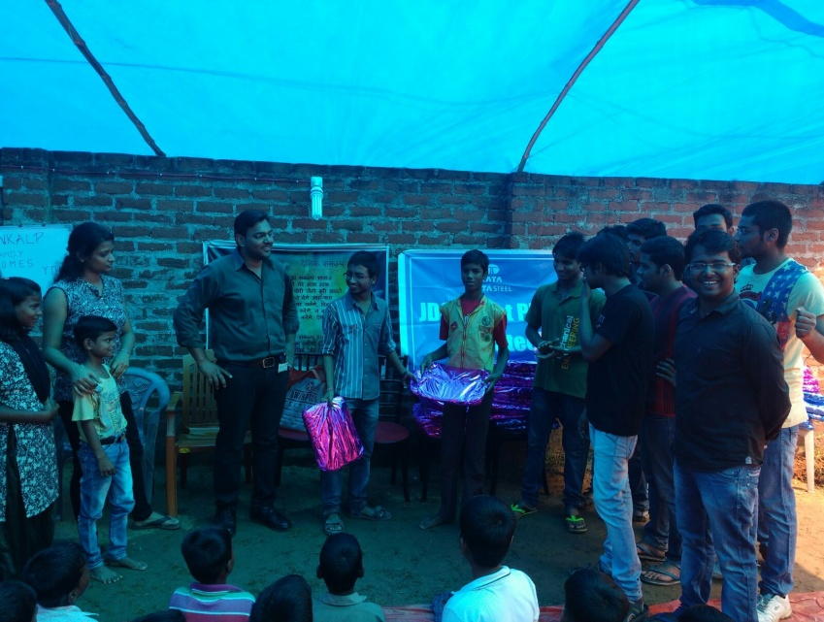
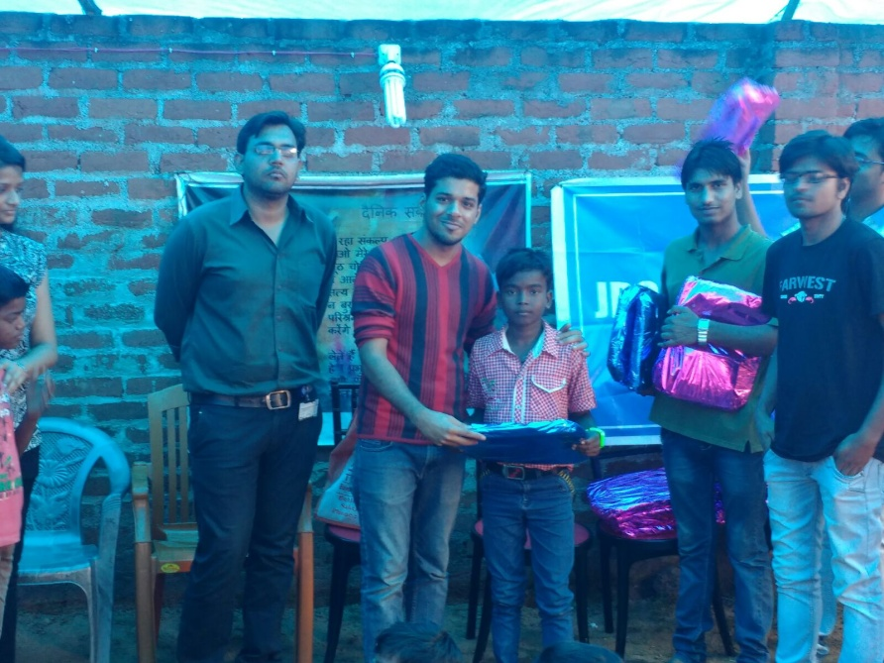
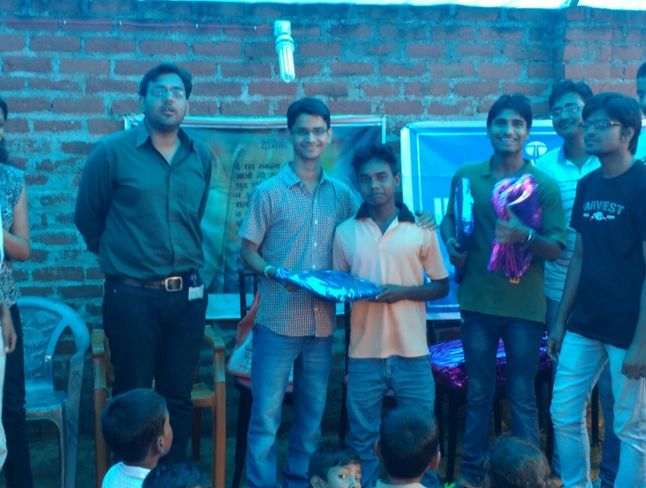

Slide 11
"Change will not come if we wait for some other person or some other time. We are the ones we've been waiting for. We are the change that we seek.“

Slide 12
COME BE A PART OF THE JOURNEY
You can donate at any our centres by just making a call to Sankalp-A Pledge to Change volunteers.
All our centres are Adityapur based and run 6 days a week
You may donate books from
Class 1-8- Course Text Books (Any Board)
Story Books
Unused stationery
Any other items like bag, toys, uniforms etc.
Relevant Contact Nos. Are
Subodh Kumar Das-9798756336
Mayank Aggarwal -9031975746
Suresh Pareek -7209632032
Vikas Dixit -9472706225

Slide 13
ACCOUNT DETAILS FOR SUPPORT
Sankalp Account Details
You can transfer funds online into our account:-
“SANKALP” A/C No.-31114719936
CIF No: 85757412911
IFSC Code: SBIN0001882
MICR Code: 831002004
Branch code: (1882)
Branch: SBI- RIT JAMSHEDPUR
You may also visit our website and pay through online link available over it.
www.sankalpnitjamshedpur.org

Slide 14
“You have not lived today until you have done something for someone who can never repay you.”
www.sankalpnitjamshedpur.org

